Slide 1
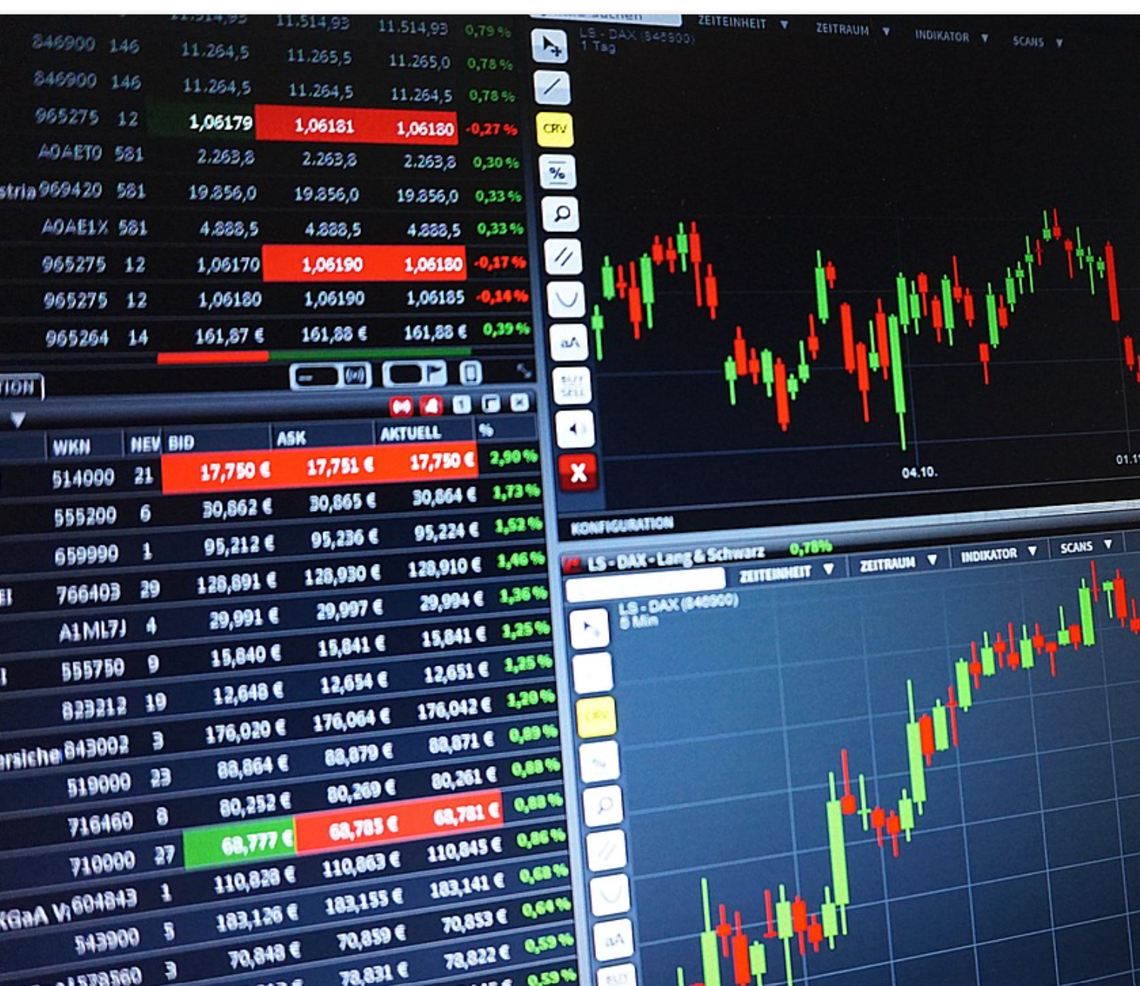
Stocks Analysis and Trading Strategies
VISHAL RASTOGI
02/2023

Slide 2
PROBLEM STATEMENT
How can Data Science be leveraged to evaluate and develop trading strategies, which can outperform the market returns for year 2022 for selected US Stocks and ETFs in 3 months
Scope:
Daily closing price data for stocks and etfs available at Yahoo Finance API will be used for developing and back testing different models
Criteria for Success:
Successfully develop models based on Bollinger bands, MACD, Relative Strength index, neural network in 3 months
Constraints:
Fluctuation of stock price within day could not be considered
Stock prices are affected by economic factors like inflation, bond prices and federal interest rates and may adversely impact the trading models.
Stakeholders
Stock Analysts, Economists, Financial Advisors and Data Scientists
Key data sources
https://pypi.org/project/yfinance/Metadata

Slide 3
Bollinger Bands
Bollinger Bands® are composed of three lines.
One of the more common calculations uses a 20-day simple moving average (SMA) for the middle band.
The upper band is calculated by taking the middle band and adding twice the daily standard deviation to that amount.
The lower band is calculated by taking the middle band minus two times the daily standard deviation

Slide 4
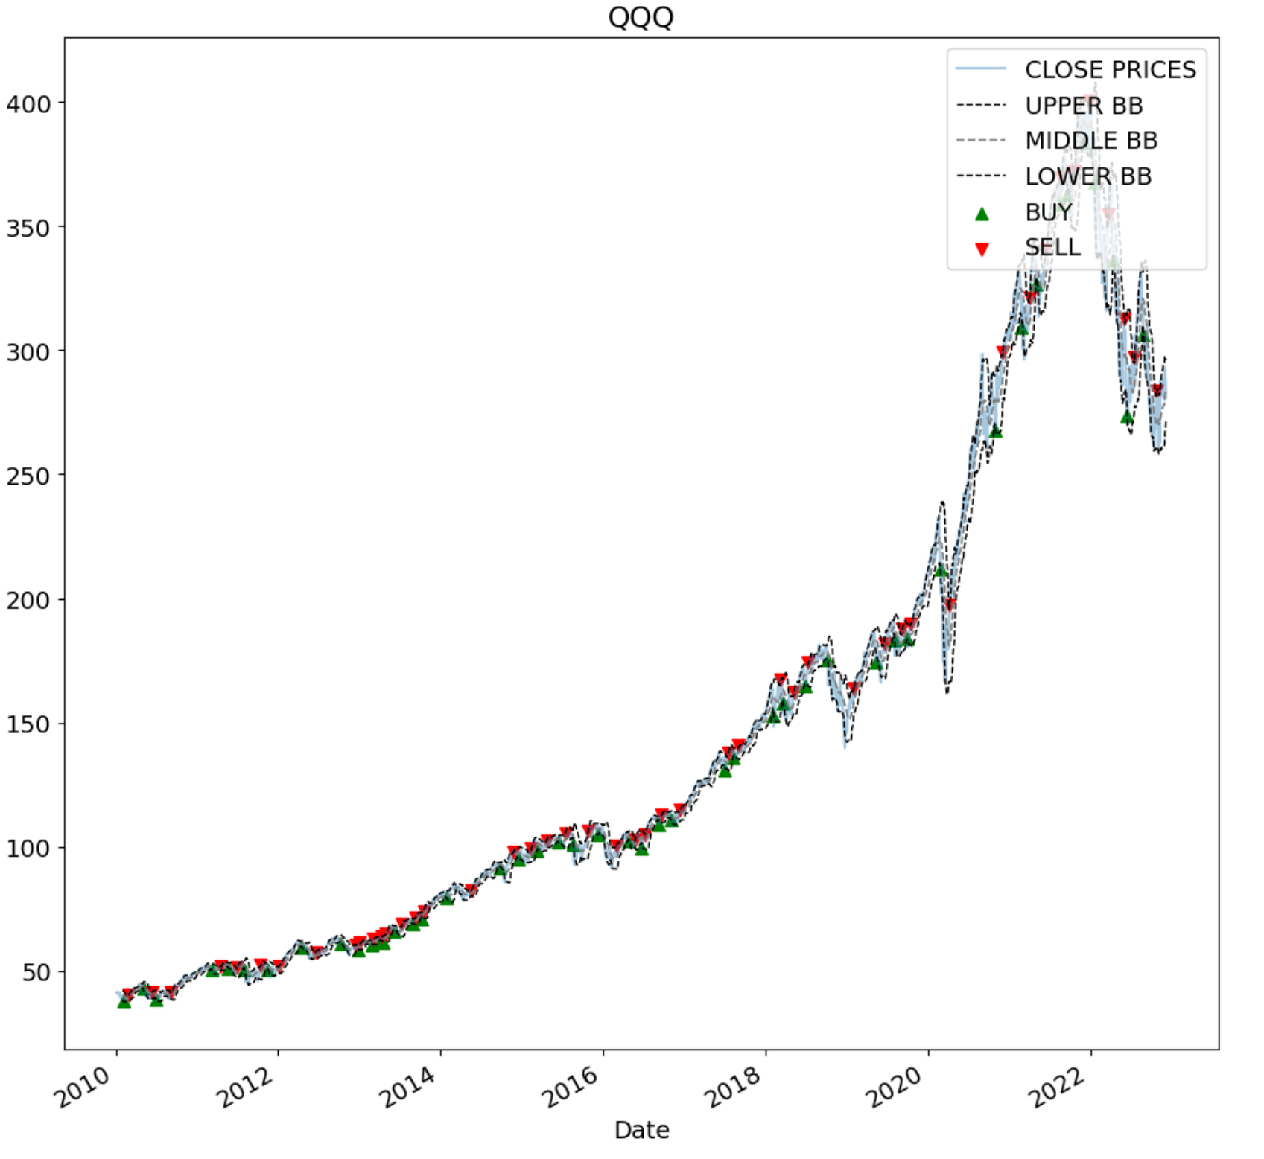
Bollinger Bands (Up trending Scenario)
QQQ(2010-01-04 TO 2022-12-07) Profit% One Time Investment-584.23% Profit% BB- 2.23%
SPY(2010-01-04 TO 2022-12-07) Profit% One Time Investment-343.2% Profit% BB- 1.93%
DIA(2010-01-04 TO 2022-12-07) Profit% One Time Investment-325.03% Profit% BB- 1.86%

Slide 5
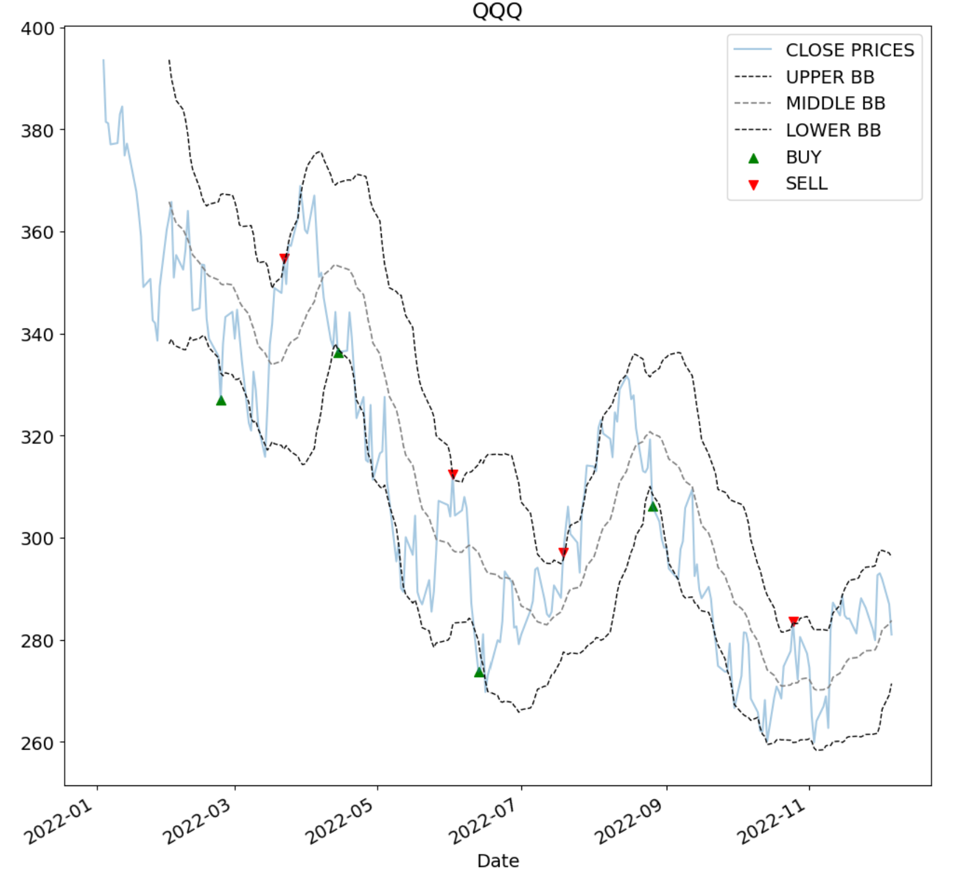
Bollinger Bands (Down trending Scenario)
QQQ(2022-01-04 TO 2022-12-07) Profit% One Time Investment 28.6% Profit% BB 0.37%
SPY(2022-01-04 TO 2022-12-07) Profit% One Time Investment 2.44% Profit% BB- 16.58%
DIA(2022-01-04 TO 2022-12-07) Profit% One Time Investment 2.11% Profit% BB 6.95%

Slide 6
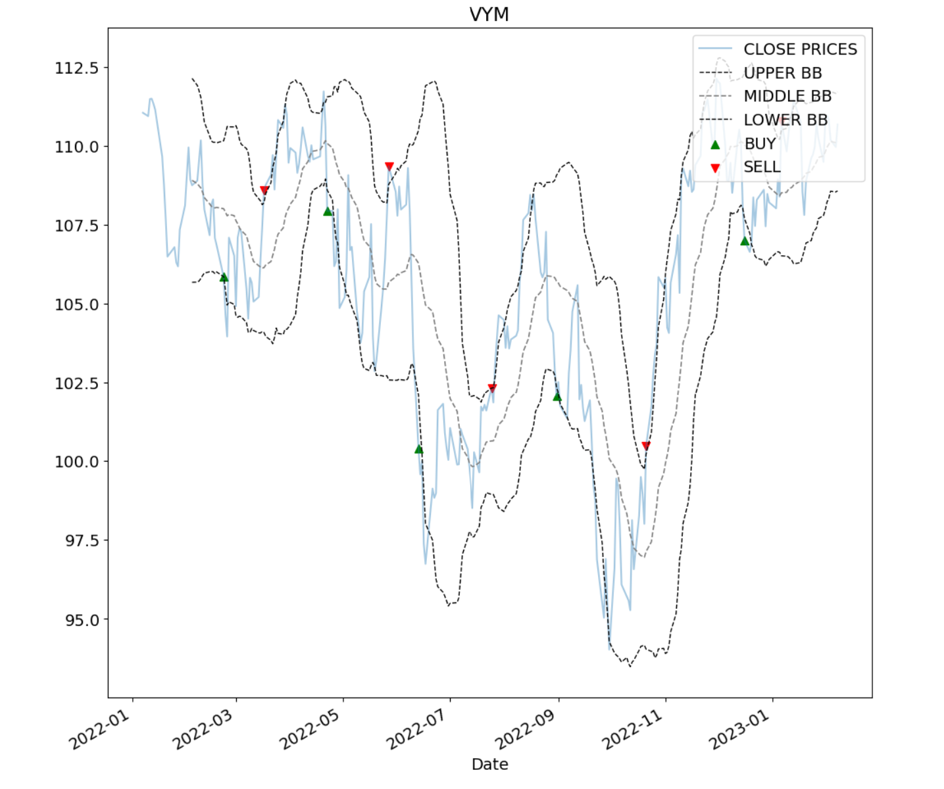
Bollinger Bands (No trend Scenario)
VYM(2022-01-07 TO 2023-02-08) Profit% One Time Investment 0.33% Profit% BB 1.58%

Slide 7
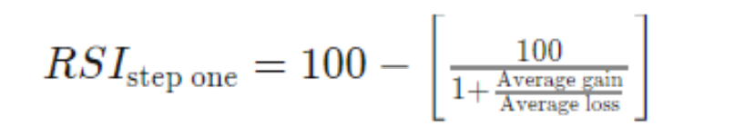
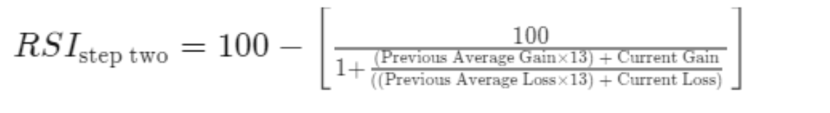
Relative Strength Index
Relative Strength Index measures the momentum and is a oscillator which moves between 0 and 100.
When the RSI drops below 30, it indicates the market is oversold and when it goes above 70 it indicates overbought level.
RSI calcuation is done in two steps. Initial 14 days RSI is calculated in step 1 and later period RSI is calculated in Step 2

Slide 8
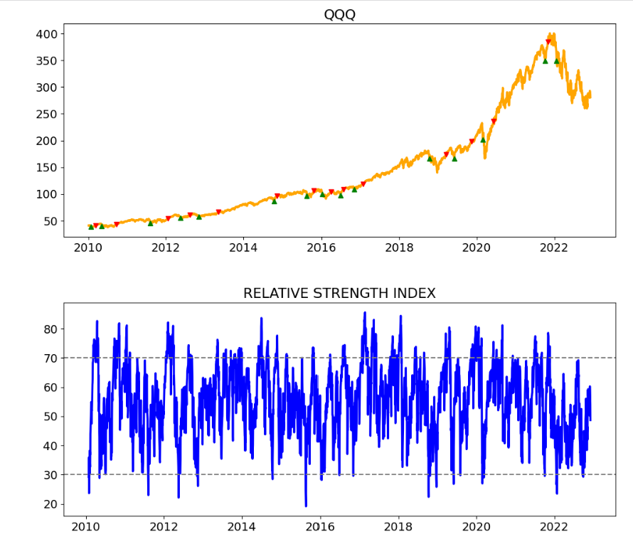
RSI (Up trending Scenario)
QQQ(2010-01-04 TO 2022-12-07) Profit% One Time Investment-584.23% Profit% RSI- 6.0%
SPY(2010-01-04 TO 2022-12-07) Profit% One Time Investment-343.2% Profit% RSI- 5.58%
DIA(2010-01-04 TO 2022-12-07) Profit% One Time Investment-325.03% Profit% RSI- 6.92%

Slide 9
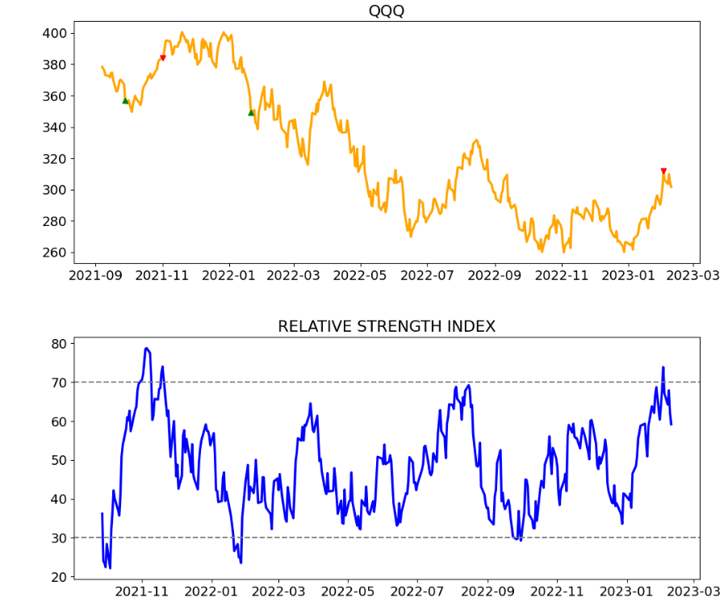
RSI (Down trending Scenario)
QQQ(2021-09-04 TO 2023-02-10) Profit% One Time Investment 15.44% Profit% RSI 1.43%
SPY(2021-09-04 TO 2023-02-10) Profit% One Time Investment 3.26% Profit% RSI 5.37%
DIA(2022-01-04 TO 2022-12-07) Profit% One Time Investment 1.22% Profit% RSI 5.43%

Slide 10
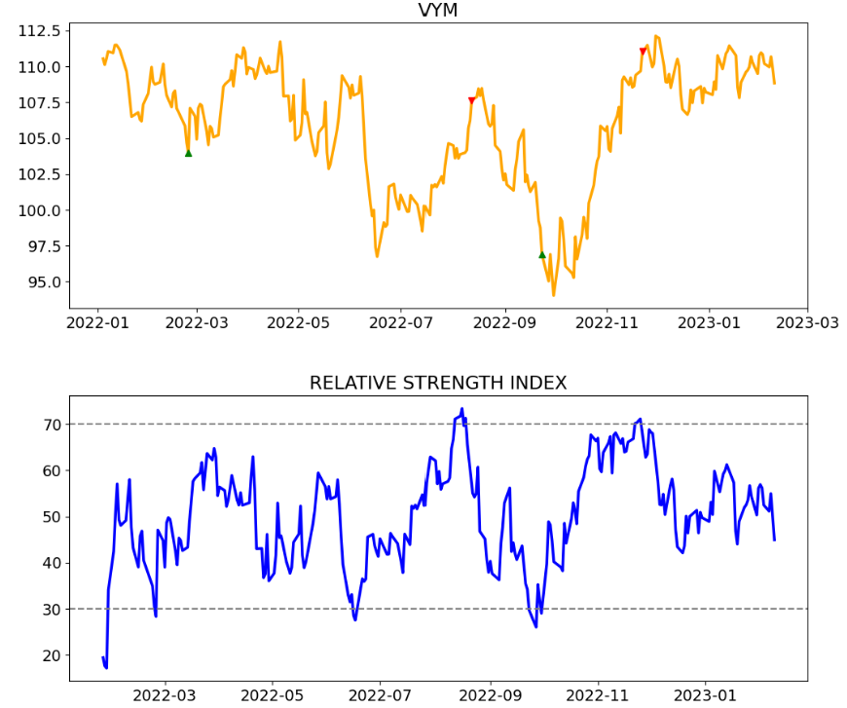
RSI (No trend Scenario)
VYM(2022-01-04 TO 2023-02-10) Profit% One Time Investment 4.69% Profit% RSI 8.9%

Slide 11
Moving Average Convergence Divergence (MACD)
MACD is a momentum-based trend indicator and is based on the convergence and divergence of 12 and 26 period exponential moving average(EMA).
Fast Line : This line represents short term exponential moving average, which is 12 period EMA
Slow Line : This line represents long term exponential moving average, which is 26 period EMA
MACD Line : 12 period EMA- 26 period EMA
Signal Line: This line is the 9 period EMA of MACD
MACD histogram : MACD Line -Signal Line
Zero Line : It's the base line with value of zero, and on this line MACD histogram is plotted. Generally, positive values of MACD bars are shown as Green ans negative values are shown as Red

Slide 12
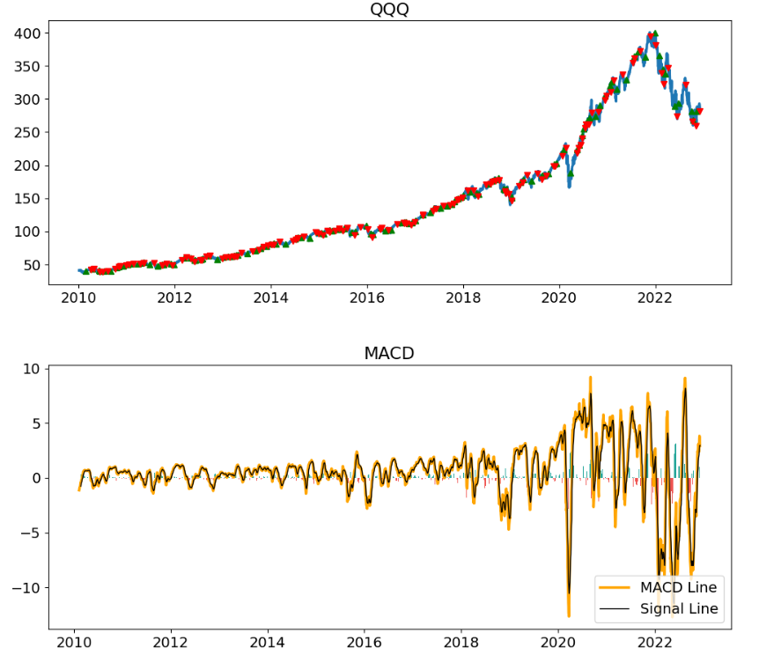
MACD (Up trending Scenario)
QQQ(2010-01-04 TO 2022-12-07) Profit% One Time Investment 584.23% Profit% MACD 0.73%
SPY(2010-01-04 TO 2022-12-07) Profit% One Time Investment 343.2% Profit% MACD 0.6%
DIA(2010-01-04 TO 2022-12-07) Profit% One Time Investment-325.03% Profit% MACD 0.81%

Slide 13
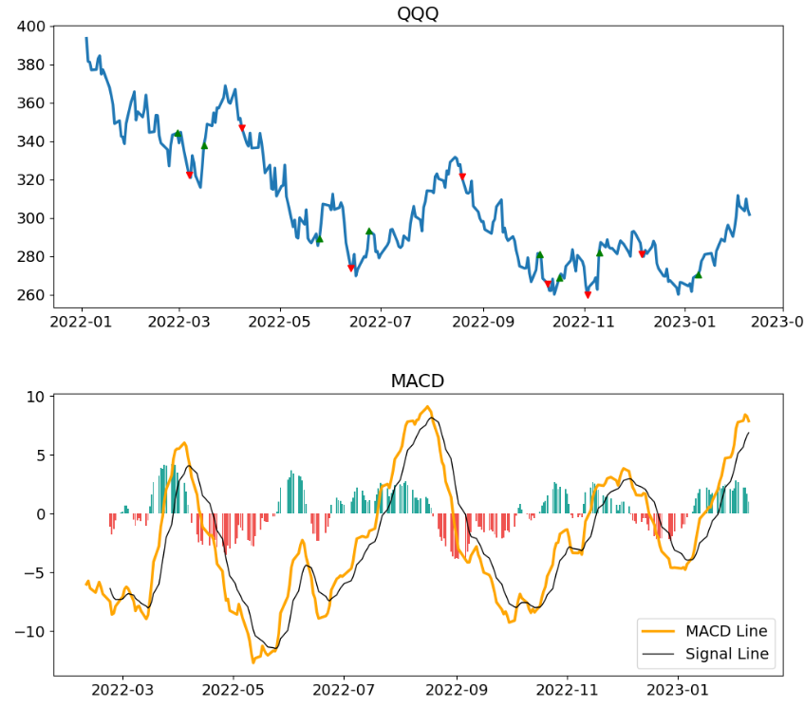
MACD (Down trending Scenario)
QQQ(2022-01-04 TO 2023-02-10) Profit% One Time Investment 23.35% Profit% MACD 1.22%
SPY(2021-09-04 TO 2023-02-10) Profit% One Time Investment 7.75% Profit% MACD 0.15%
DIA(2021-09-04 TO 2023-02-10) Profit% One Time Investment 1.51% Profit% MACD 0.68%

Slide 14
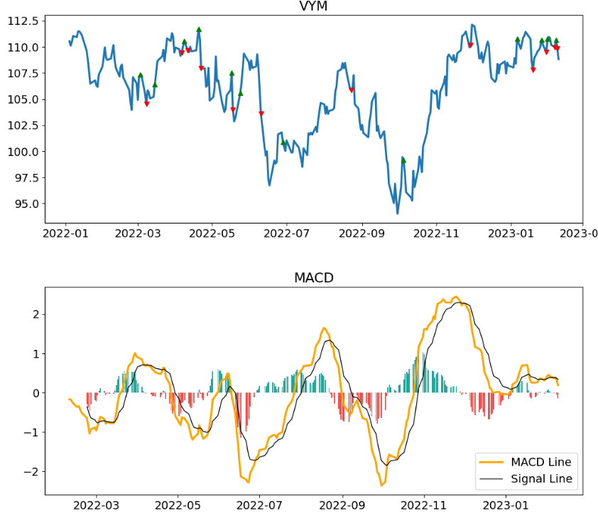
MACD (No trend Scenario)
VYM(2022-01-04 TO 2023-02-10) Profit% One Time Investment 1.53% Profit% MACD 0.01%

Slide 15
Long Short-Term Memory (LSTM) Neural Network
LSTM is a type of artificial recurrent neural network, which is used in field of deep learning. It has feed back connections and can process sequence of data points.
LSTM neural network can be used for short term movement of stocks over a long period of time
Optimizer- Adam
Loss Function-’Mean Squared Error

Slide 16
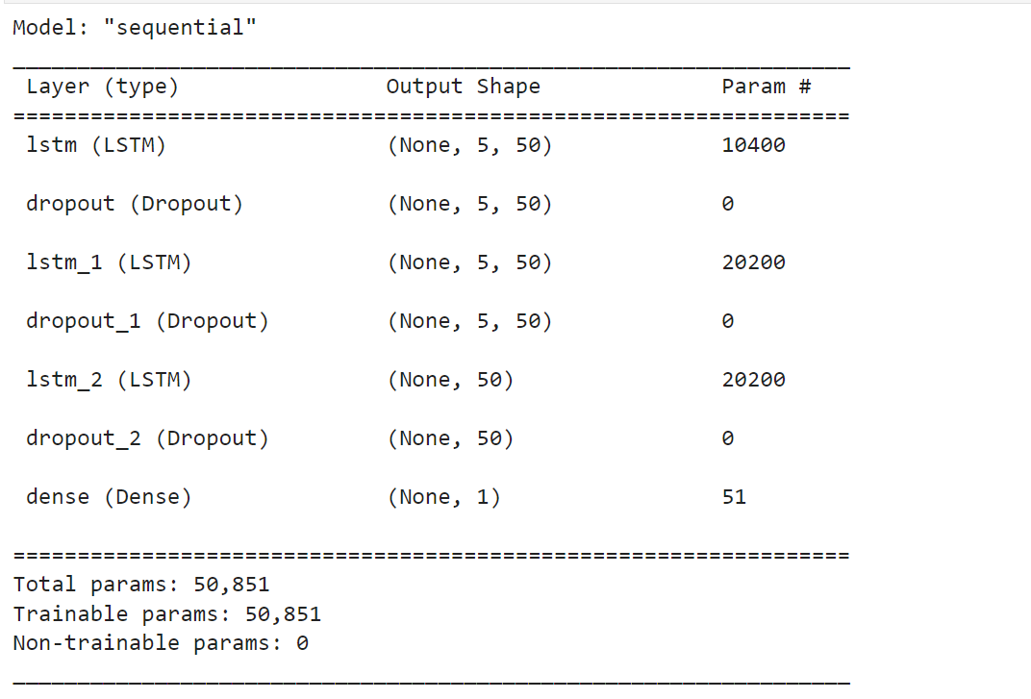
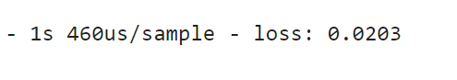
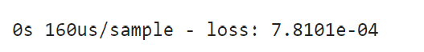
LSTM Model
No. of epochs used :50
Trained on 3060 days of closing prices
Loss after first epoch:
Loss after last epoch:

Slide 17
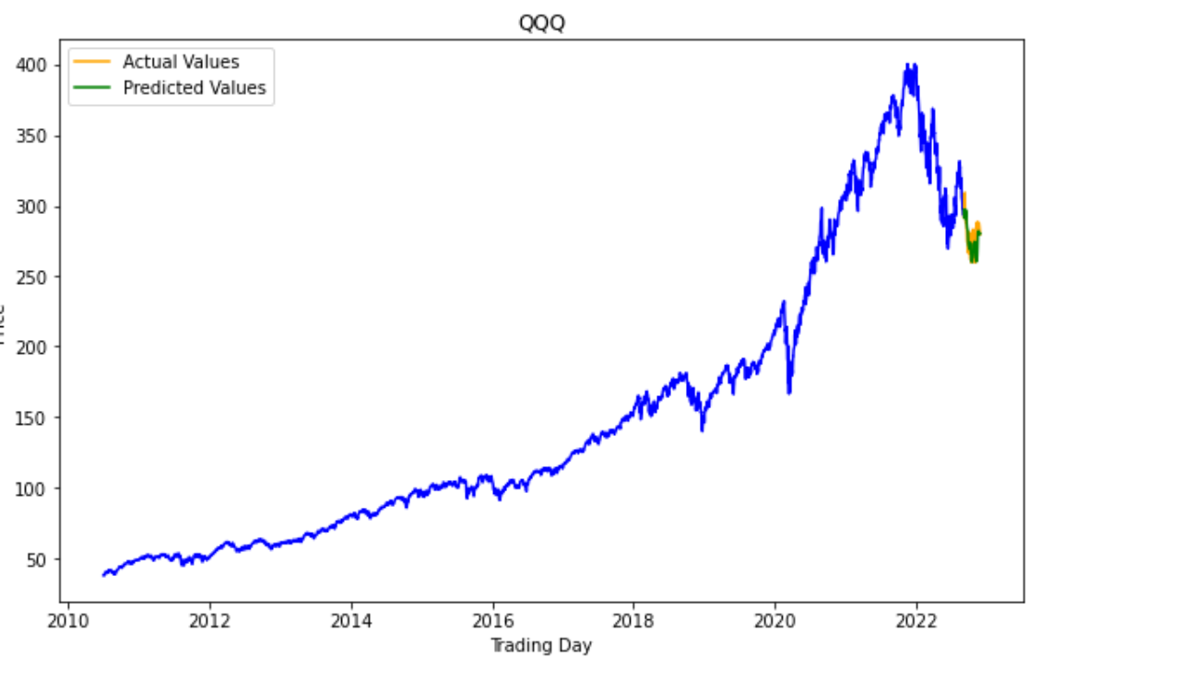
LSTM Model Forecast for ETF “QQQ”
Predicted Value for 60 periods

Slide 18
Conclusion
Bollinger Band Strategy, Relative Strength Strategy and MACD did not perform well on up trending market, compared to buy and hold strategy.
Bollinger Band Strategy, Relative Strength Strategy and MACD outperformed the buy and hold strategy for both down trending and non-trending stocks.
Relative Strength Index Strategy performed far better than Bollinger Band and MACD strategy for all three price trend scenarios
LSTM neural network did show good predictability for exchange traded fund “QQQ”
Macro-economic conditions should be considered along with fundamental of stocks in making investment decisions.
In general, all 3 exchange traded funds performed very well over long horizon, and it would be worth while to do recurring investment over a long period of time
,

Slide 19

THANK YOU

